Slide 1
Electric motor drives for bev and hev
Torque density
The torque density is an important criterion of the electric motors.
It reflects the volume and weight of machines at given torque demand.
Required Features of Electric Motor Drives
High Efficiency
Good Dynamic Performance
High Power Density
Low cost
Reliability
Overload currents capability
Maintenance Free
Temperature resistance
Fault-tolerance
Machine type
T/V envelope
Nm/m3
Permanent
magnetic (PM)
Induction (1M)
Switched
Reluctance (SR)
28860
4170
6780

Slide 2
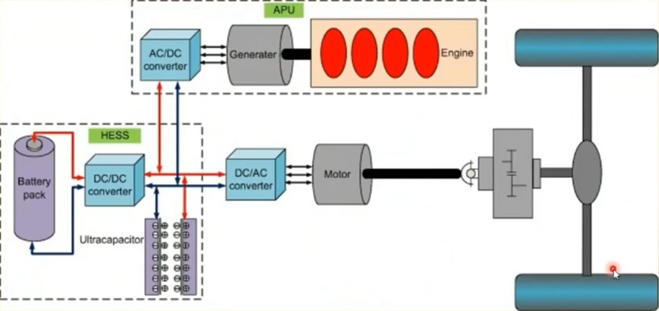
Flowchart for designing AN EV

Slide 3
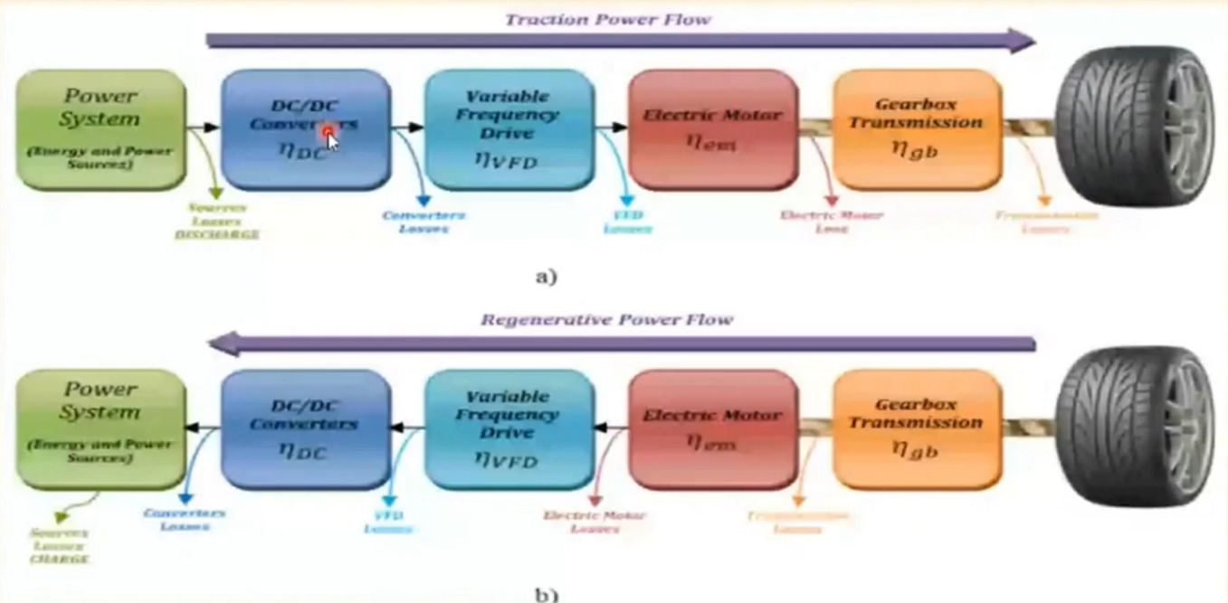
Diagram depicting losses in AN EV

Slide 4
The need for better batteries
Current battery tech: Lithium ion technology
Same technology as in cell phones, laptops, etc.
Li-ion battery energy density: 210Wh per kg
Current Li-ion batteries give the average electric car a range of about 160km(99.4 miles)
Why does battery technology need to be improved?
Limits electric car range
Limits electric car performance
Results in electric vehicles being less viable than traditional cars

Slide 5
Top reasons to drive an electric vehicle
electricity
rates
more stable than
gasoline prices
Grants, Rebates
and Tax Credits
for new or used
EVs & chargers
Many models
listed under
$35,000 now on
the market
Free
or
reduced
taxes
Cheaper to
Charge
than to
fill the tank
Higher upfront
cost is typically
paid back by
50,000 miles
Maintenance
Costs are lower,
especially with
long battery
warranties

Slide 6
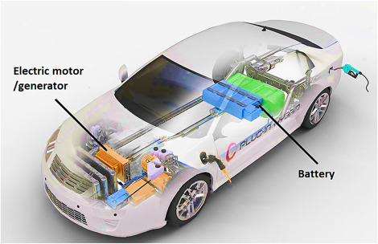
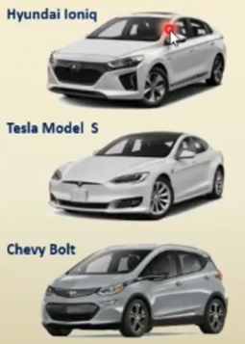
BEV : Battery electric vehicles
BEV
How does it work?
PEV
Battery
charged
using
Electricity
Battery
powers
Electric
Motor
Electricity
accessed
through
Plug

Slide 7
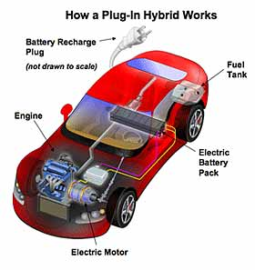
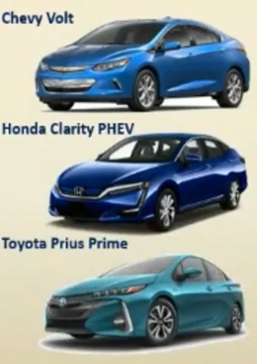
PHEV: PLUG- IN Hybrid electric vehicle
BEV
EREV
How does it work?
Battery
Charged
using
Electricity
electricity
accessed
through
plug
PEV
Battery
Charged
using
Electricity
Battery
Charged
using
Electricity
Battery
Charged
using
Electricity

Slide 8
Thank you

